Slide 1

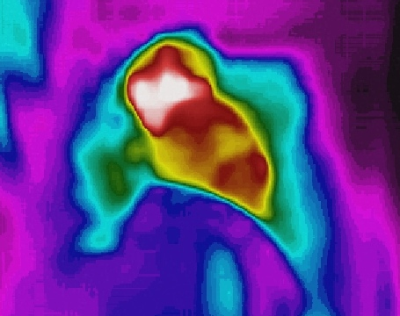
AIoT Bedroom
Au Ka Long(04)
Project ID: P21

Slide 2

Problem & Solution

Slide 3
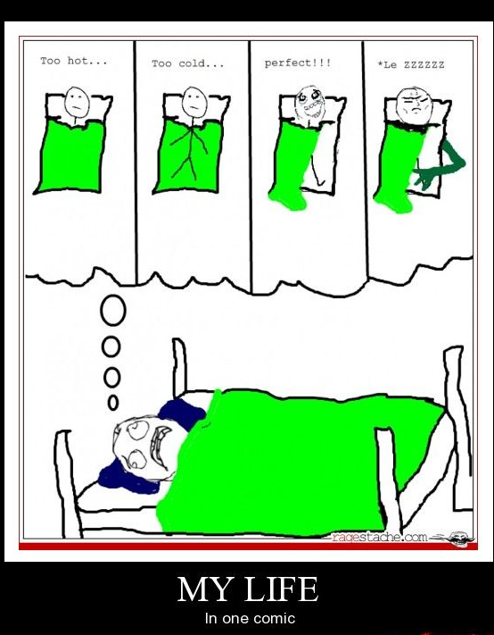

Problems
Find these problems from these memes
These problems are in our daily life
Try to solve them with AI and IoT

Slide 4

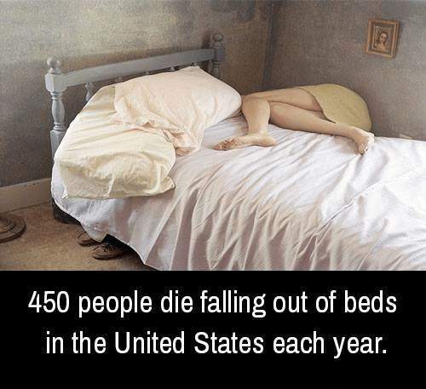

Furthermore
& ~30% of home accidents
Try to create a safe and relaxing place
Achieve total relaxation
Achieve worry-free place
10-year average, Underlying Cause of Death 2014,CDC,http://wonder.cdc.gov/ ;
SLIP, TRIP AND FALL ACCIDENTS: LIST OF SURPRISING STATISTICS: https://callsam.com/blog/slip-trip-and-fall-accidents-list-of-surprising-statistics/, data from CDC,OSHA, etc.

Slide 5
Solution
Auto lights off when you are ready to sleep
Auto lights on when you are using phone
Auto change temperature of aircon when you are hot or cold
Auto call for ambulance when you get hurt and faint
Auto play music when you are on bed

Slide 6
Solution
Monitoring
Bedroom
Detection
Automation

Slide 7
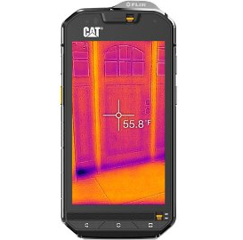
Actual technology Used

Slide 8
Simple Workflow
Socket
AI analysis (Yolo v5)
Software
Android App (Java code)
Send data from Thermal Camera
PC (Jupyter Notebook)
Get data
Visual image
Thermal image
Algorithms
Detection
IoT Automation

Slide 9
Simple Workflow
Thermal Camera
Thermal Image
Visual Image
Network
PC
CPU/GPU
Network
Hardware
IoT Devices
Automation

Slide 10
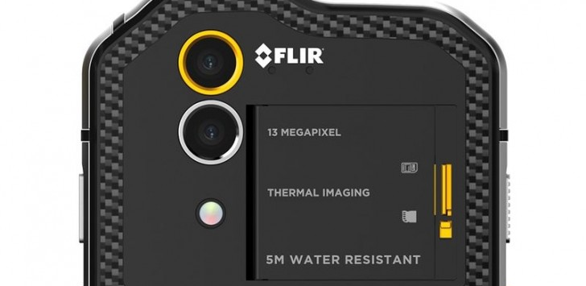
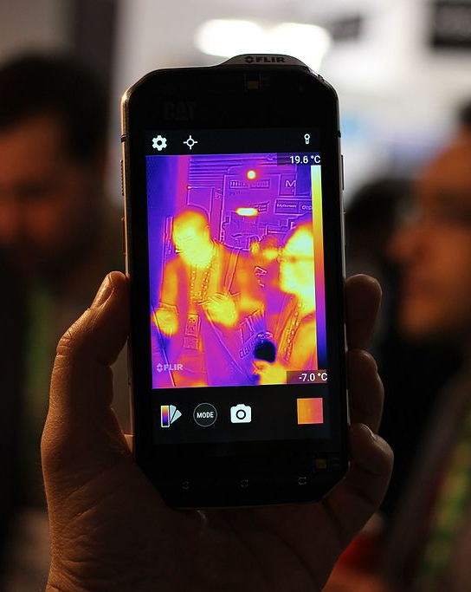
Hardware -------------------- Thermal camera
Thermal Camera
Visual Camera
Cat S60 is being used
Relative low price
Built-in WIFI
Android OS

Slide 11
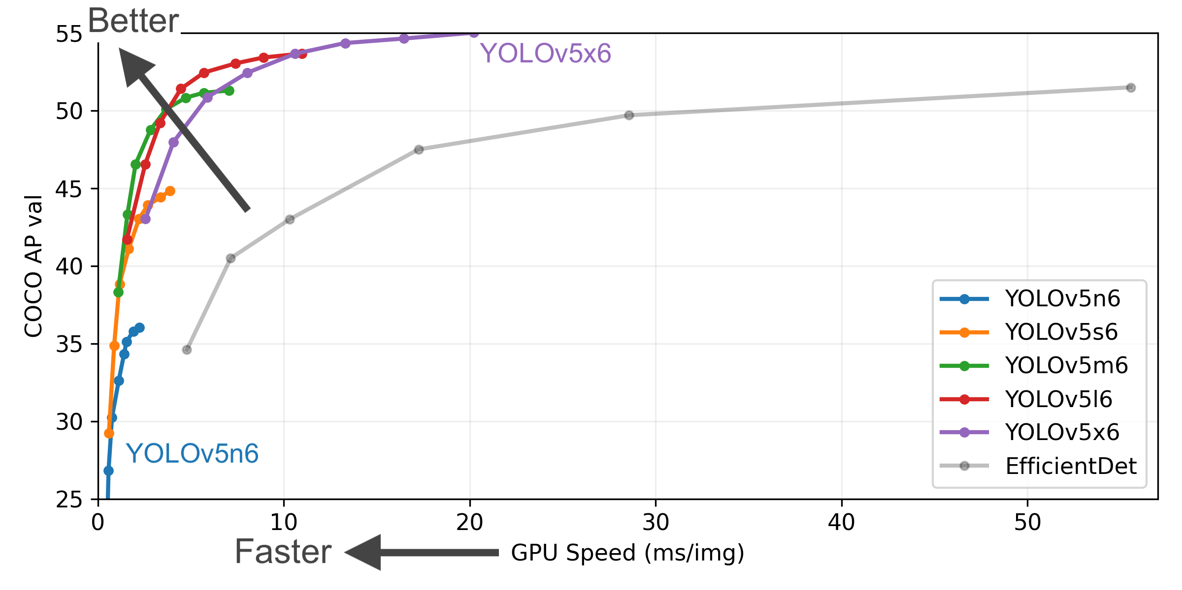
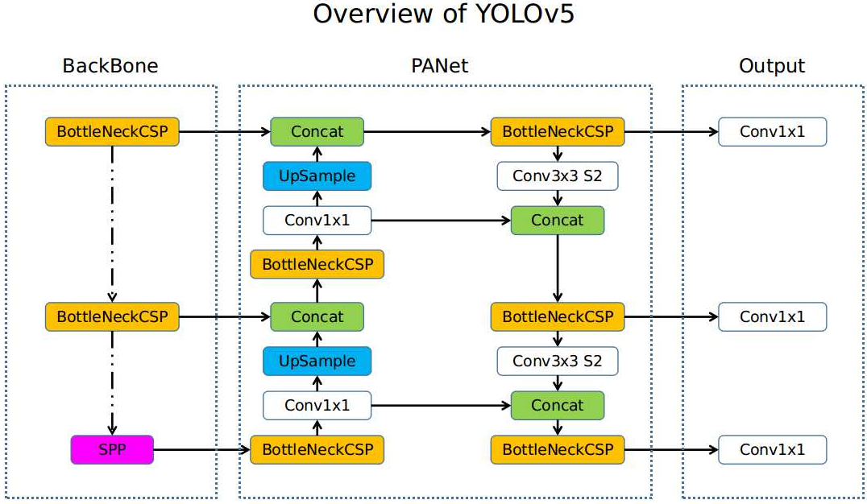
Detection(AI) --- YOLO v5
Model for object detection
One of the most reputable model
Quick and efficient
Note(in my project):
Only human, bed, phones are set to detect
Yolov5x6 is being use as default

Slide 12

Detection(Algorithms)
Sleeping detect algorithm
Bed lying detect algorithm
Using(touching) phone detect algorithm
Human movement detect algorithm
Bed temperature
Body temperature

Slide 13
Detection(Algorithms) --- Bed lying detection
Lying Detection
By ratios of human body
Shoulder-height: 1:4
Adding some tolerances
Check whether obey this ratio
On Bed Detection
The percentage of human is inside of the bed
Check if is in an acceptable percentage
Lying Detection
On Bed
Detection
Bed Lying
Proportions of the Human Body with Respect to the Height of the Head: https://www.researchgate.net/figure/Proportions-of-the-Human-Body-with-Respect-to-the-Height-of-the-Head_fig4_228867476

Slide 14
Detection(Algorithms) --- Sleep mood
Bed
Lying
Touch
Phone
Sleep mood
Touch Phone Detection
The percentage of phone is inside of the human
Check if is in an acceptable percentage

Slide 15
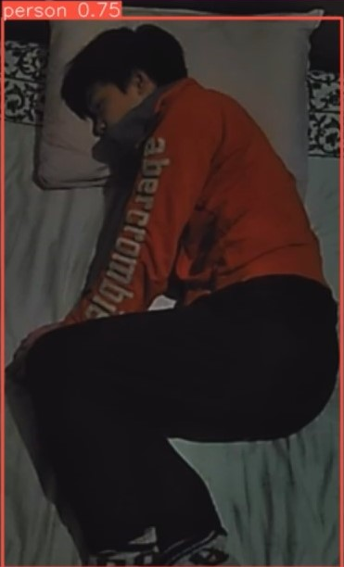
Detection(Algorithms) --- Body temperature
Exclude the values that are out of the box
Exclude empty spaces (extreme values)
Calculate average temperature of the person
Empty spaces

Slide 16
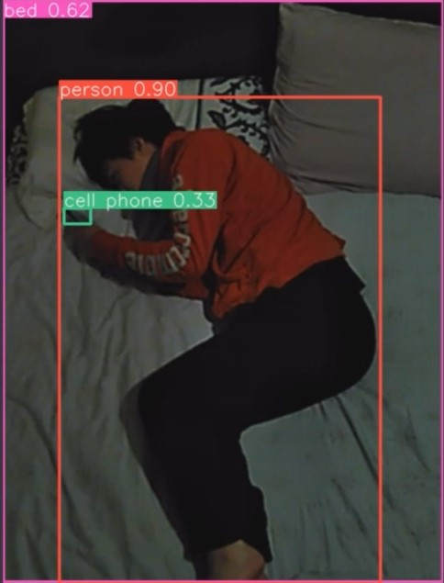
Detection(Algorithms) --- Bed temperature
Exclude the objects outside the box
Exclude other objects
Calculate average temperature of the bed
Other objects

Slide 17
Detection to IoT automation
Extensibility
Air-conditioner
Bed temperature
Body temperature
Lights
Sleeping mood
Touching phone
Ambulance
Not moving & Fall off bed
Fever/ Hypothermia
Music
Lying on bed
Start sleep

Slide 18
Workflow
Socket
AI analysis (Yolo v5)
Software
Thermal Camera
Send data
Get data
Thermal image
Algorithms
Detection
IoT Automation
Visual image
PC

Slide 19

Future

Slide 20
Future Development
Abandon visual image
Use custom dataset(thermal image)
Advantage
Higher privacy (faces aren’t captured)
Less data require to transfer
Current setbacks
Lack of data
Inconsistent thermal image formats
Use better Hardware
Better processor unit
Lightweight thermal camera
Advantage
Lower latency
Easier to install
Current setbacks
Lack of funding

Slide 21

What are the potential revenue streams?
Co-operate with IoT companies
Bundle our system with IoT devices
Selling IR camera with our system
Selling Bedroom IoT devices

Slide 22

Conclusion

Slide 23
Key Features
Sleeping Detections
Temperature Detections
AI Object Detection
IoT Automation

Slide 24
Highlights --- Code Language
Thermal Camera connector
Java (Android App)
Detection and Automation
Python (Jupyter Notebook)

Slide 25

Highlights --- Cat S60
Thermal Imaging for temperature detection

Slide 26
References
Proportions of the Human Body with Respect to the Height of the Head: https://www.researchgate.net/figure/Proportions-of-the-Human-Body-with-Respect-to-the-Height-of-the-Head_fig4_228867476
10-year average, Underlying Cause of Death: 2014,CDC,http://wonder.cdc.gov/ ;
SLIP, TRIP AND FALL ACCIDENTS: LIST OF SURPRISING STATISTICS: https://callsam.com/blog/slip-trip-and-fall-accidents-list-of-surprising-statistics/, data from CDC,OSHA, etc.

Slide 27

Thank you

